Slide 1
Correlation between property prices in London and surrounding venues
Ivan Stavrev
IBM Data Science Capstone Project
August 5, 2020

Slide 2
Agenda
Business problem
Data collection
data manipulation
Clustering
Results
references

Slide 3
Business problem
Optimize profit by collecting information on housing prices and the venues (shops, restaurants, parks, Hotels, etc.) that are nearby
The target audience for this report is:
Potential buyers who can roughly estimate the property price based on the surrounding venues and neighborhood location
business owners who can decide what kind of venues to build in certain neighborhoods to maximize their profit
Apartment owners who can optimize their marketing and can calculate the convenience of certain venues
Null hypothesis – properties in the center of the city are more expensive and have higher number of valuable venues (e.g. restaurants and shops)

Slide 4
Data collection
Collect data for:
List of London boroughs
Wikipedia
Average property price
Property data
Venue types
Foursquare (required by ibm)
Boroughs’ geospatial coordinates
carto

Slide 5
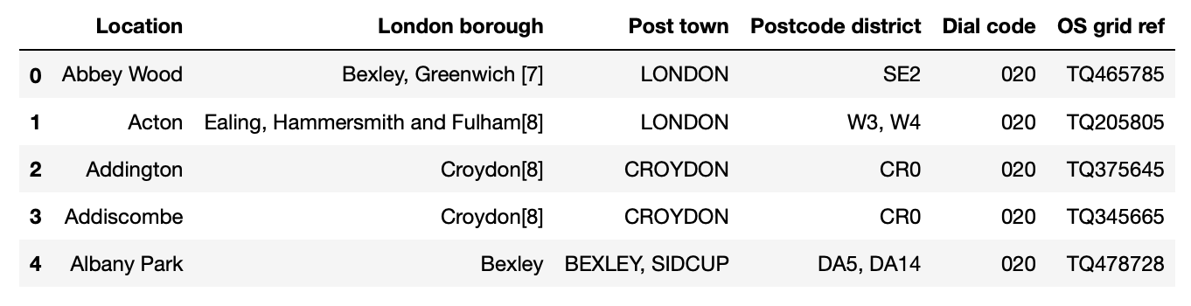
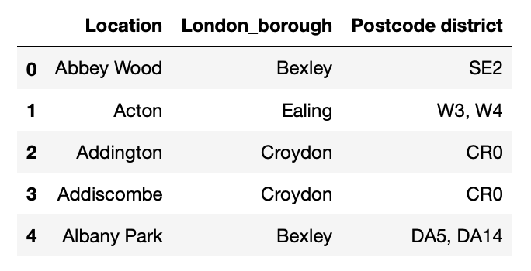
Data manipulation
Scrape data from Wikipedia
Leave relevant columns only

Slide 6
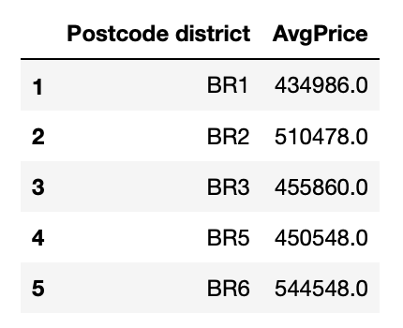
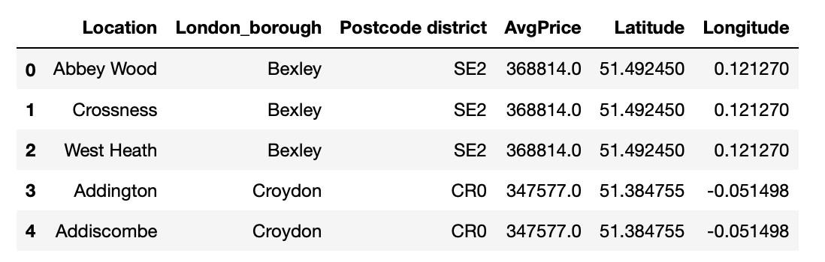
Data manipulation
Scrape data from property price
Pull geospatial coordinates using geocoder (using the city name only)
Merge tables (inner left join) to show prices by neighborhood and their coordinates

Slide 7
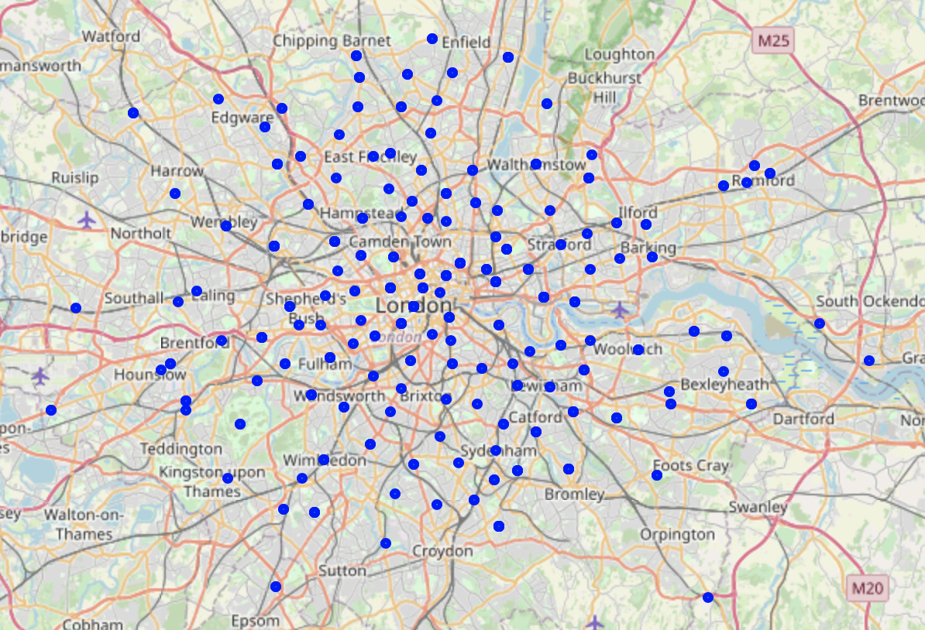
Data manipulation
Use folium to show the boroughs on a map

Slide 8
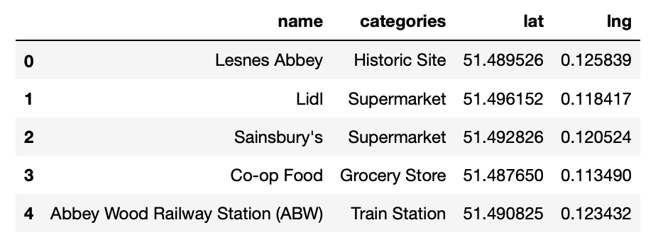
Data manipulation
Use foursquare to pull venue information
Name
Category
Longitude
latitude

Slide 9
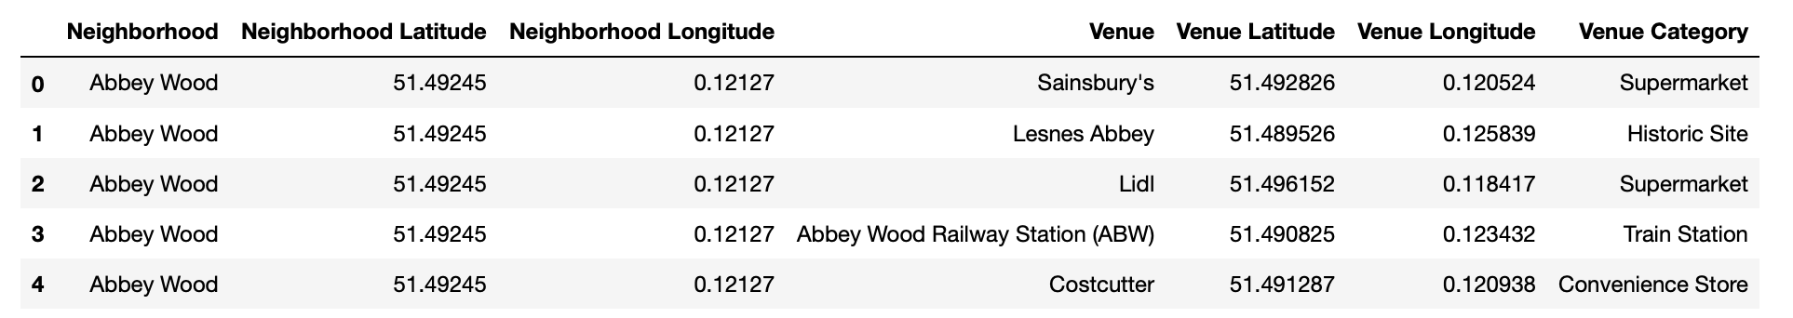
Data manipulation
Use foursquare to pull venue information
Name
Category
Longitude
latitude

Slide 10
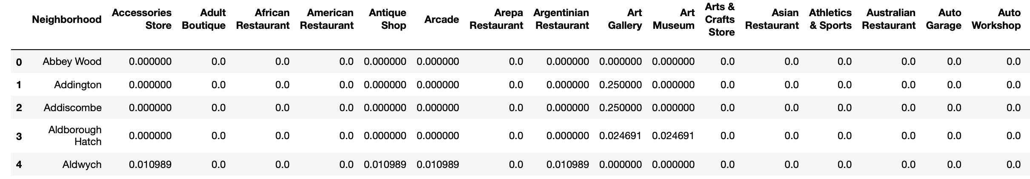
Data manipulation
Connect each borough to a venue and count how many venues (frequency) are in each neighborhood

Slide 11
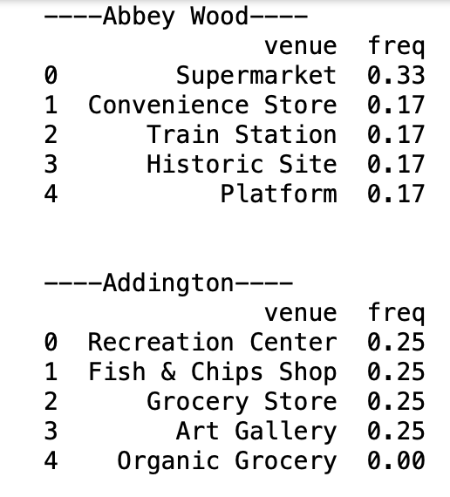
Data manipulation
Receipt view of the most frequent venues in each borough = venues are sorted from most to least

Slide 12
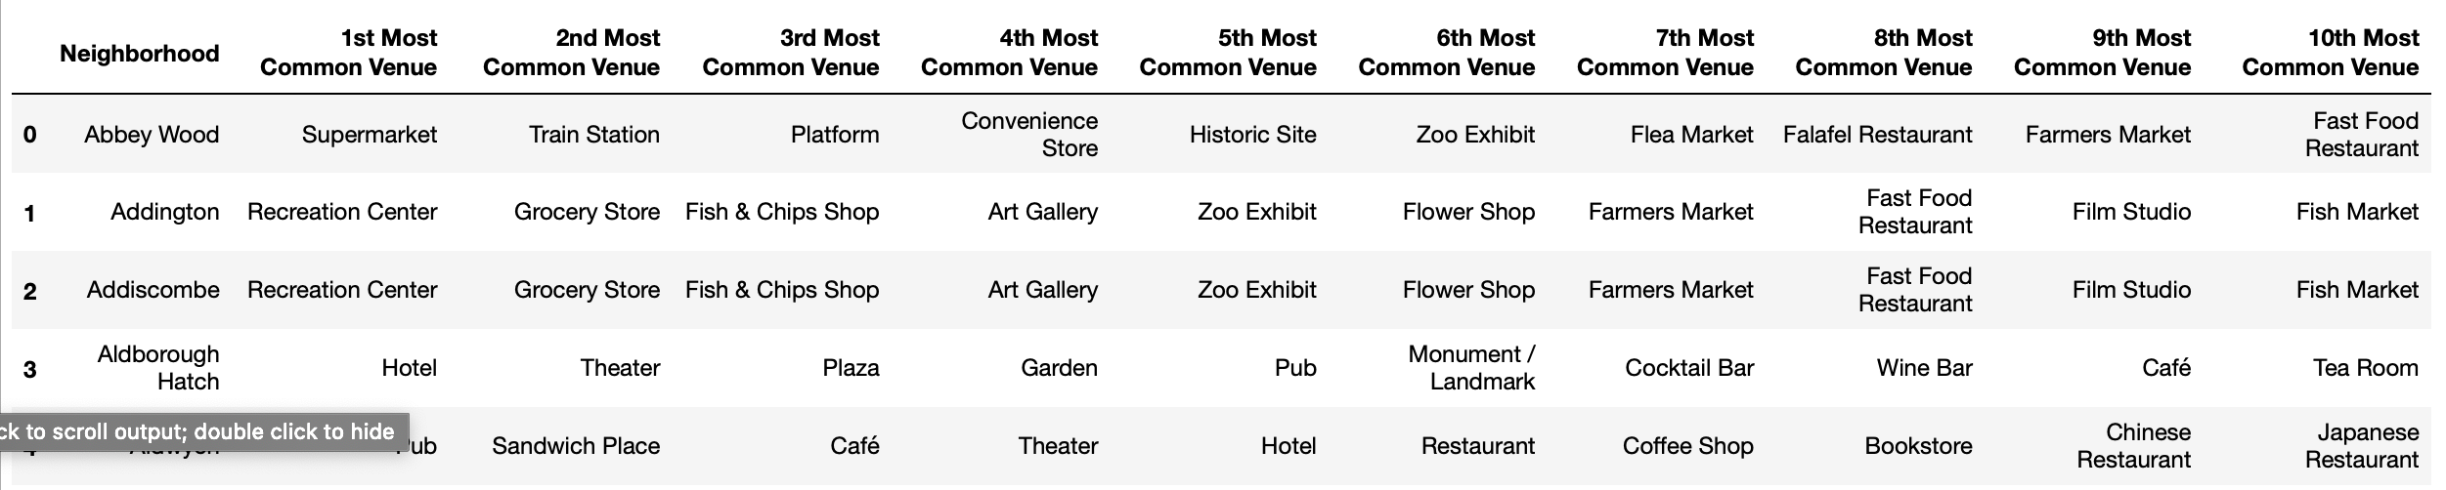
Data manipulation
Rank the most numerous venues in each borough

Slide 13
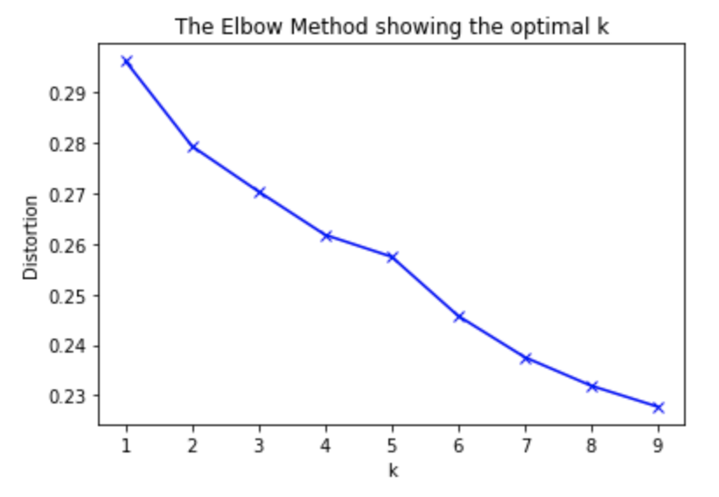
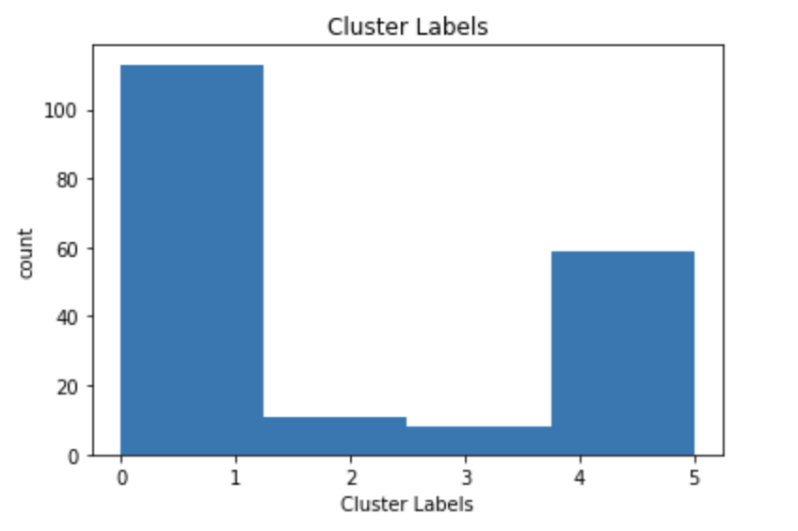
Clustering
Put neighborhoods into clusters
Include k- means using the sklearn python library
Use the ‘elbow method’ to determine the number of clusters in the dataset

Slide 14
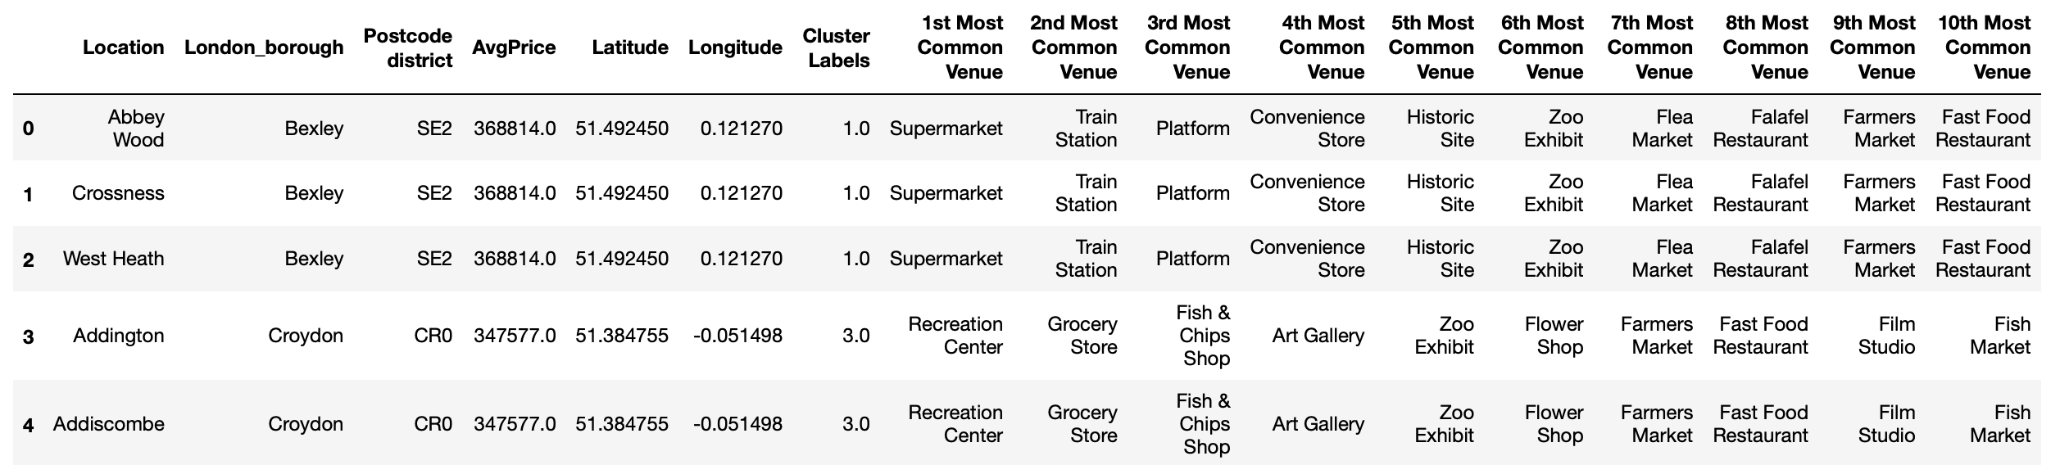
Clustering
Merge the neighborhood dataset, clusters and the most common venues

Slide 15
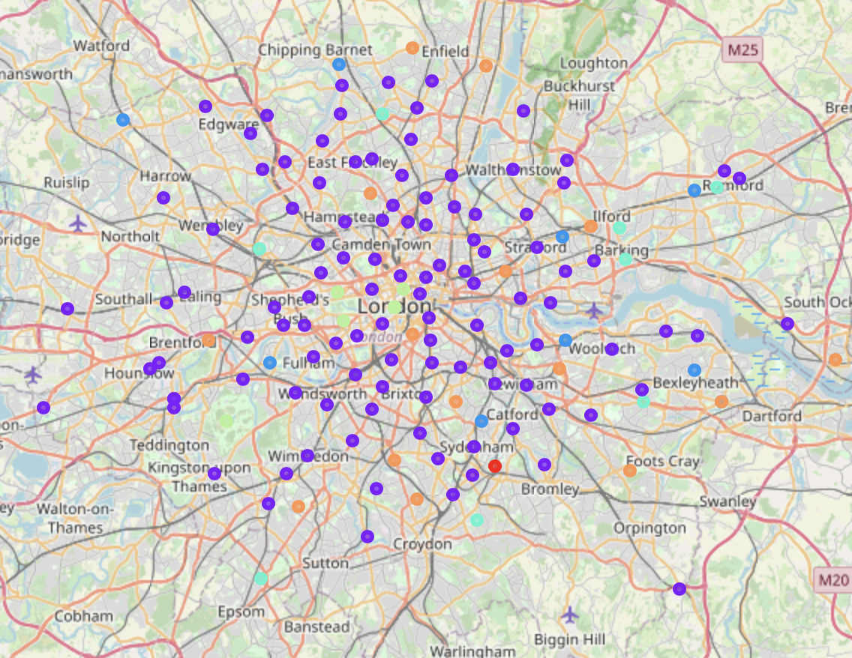
Clustering
Visualize the clusters on a map

Slide 16
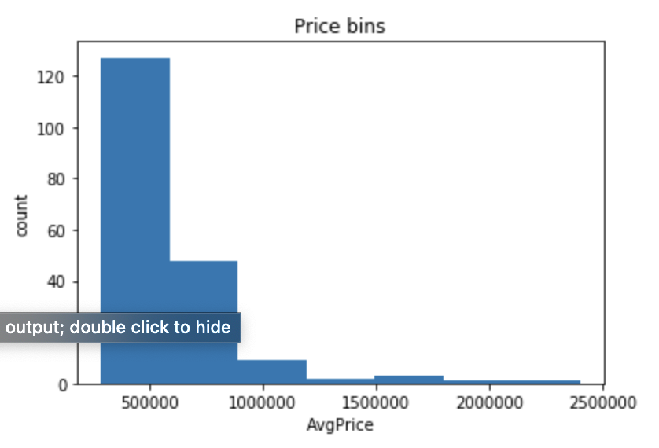
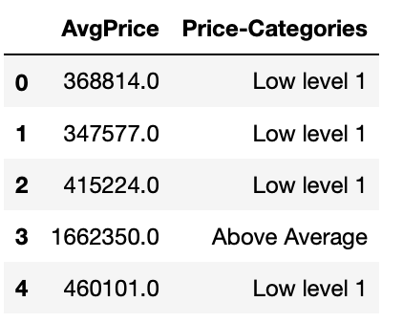
Clustering
Segment the prices into bins/categories

Slide 17
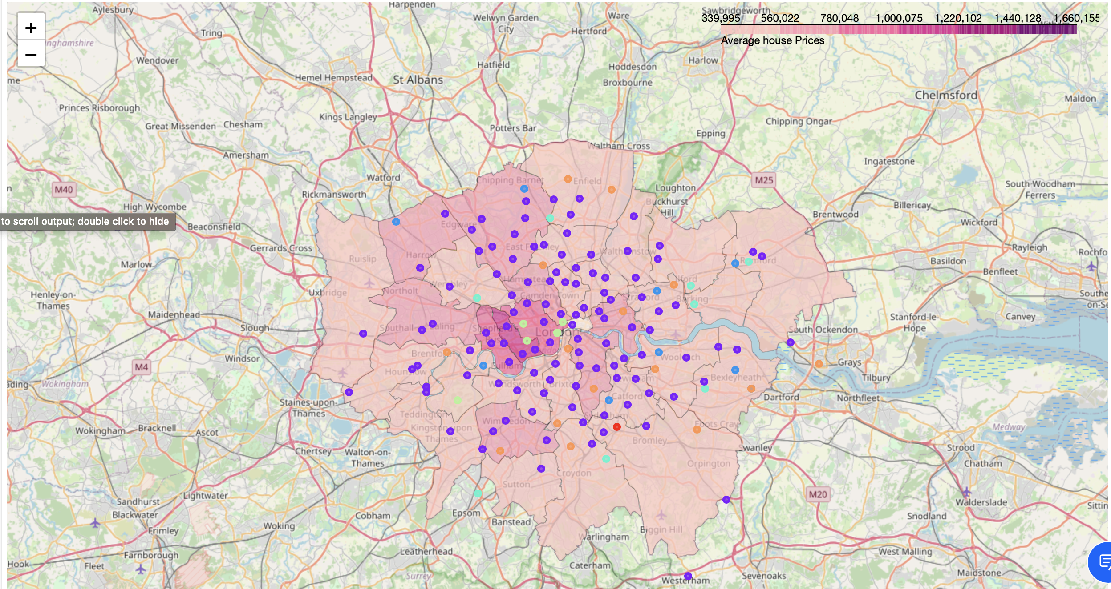
Clustering
Visualize each neighborhood and the corresponding average property prices

Slide 18
Conclusion
The final conclusions support the null hypothesis that
Property prices in the center of the city are higher than the prices in the outskirts
Venues such as ‘supermarkets’, ‘fish and chips shops’ and ‘recreation centers’ are located in some of the most expensive areas

Slide 19
references
Property Investment London - Analytics for the Capital City - PropertyData. (2020). Retrieved 5 August 2020, from https://propertydata.co.uk/cities/london
List of areas of London. (2020). Retrieved 5 August 2020, from https://en.wikipedia.org/wiki/List_of_areas_of_London
Foursquare Developer. (2020). Retrieved 5 August 2020, from https://developer.foursquare.com
(2020). Retrieved 5 August 2020, from https://joshuaboyd1.carto.com/tables/london_boroughs_proper/public

